Slide 1
ChatGPT Capabilities and Limitations
Discuss what ChatGPT can and can't do, to determine if it's suitable for your project.

Slide 2
ChatGPT Capabilities

Slide 3
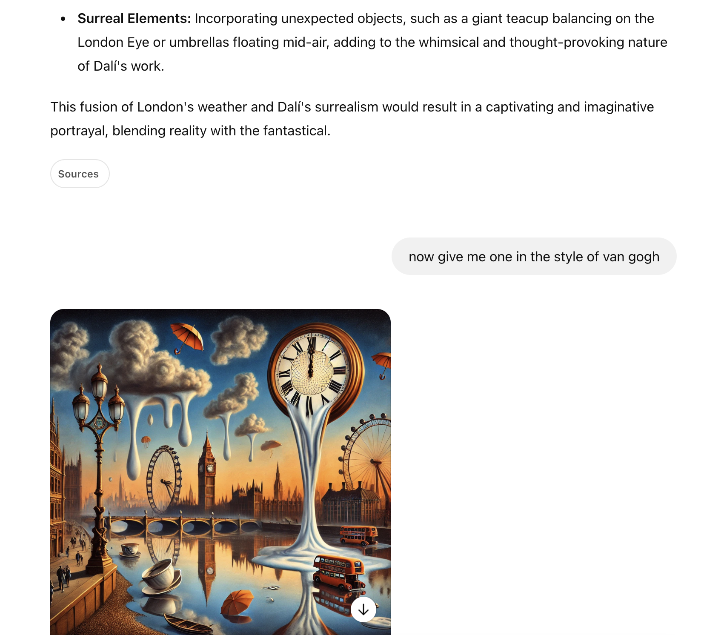
Messages - Chat History Context
ChatGPT has context about what has previously been said within the Chat History.

Slide 4
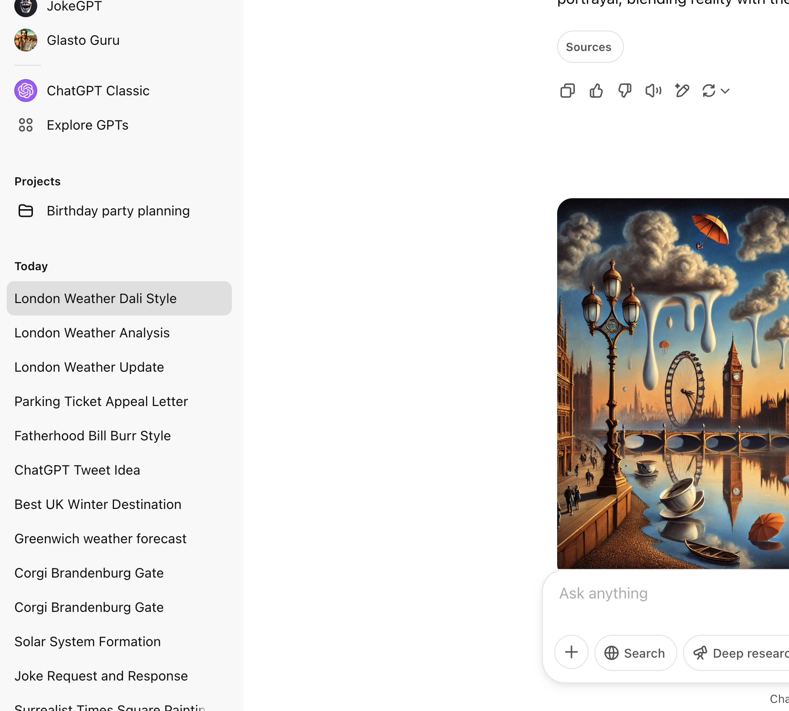
View Previous Chat Messages
You can easily view previous messages with ChatGPT.

Slide 5
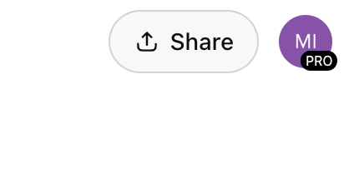
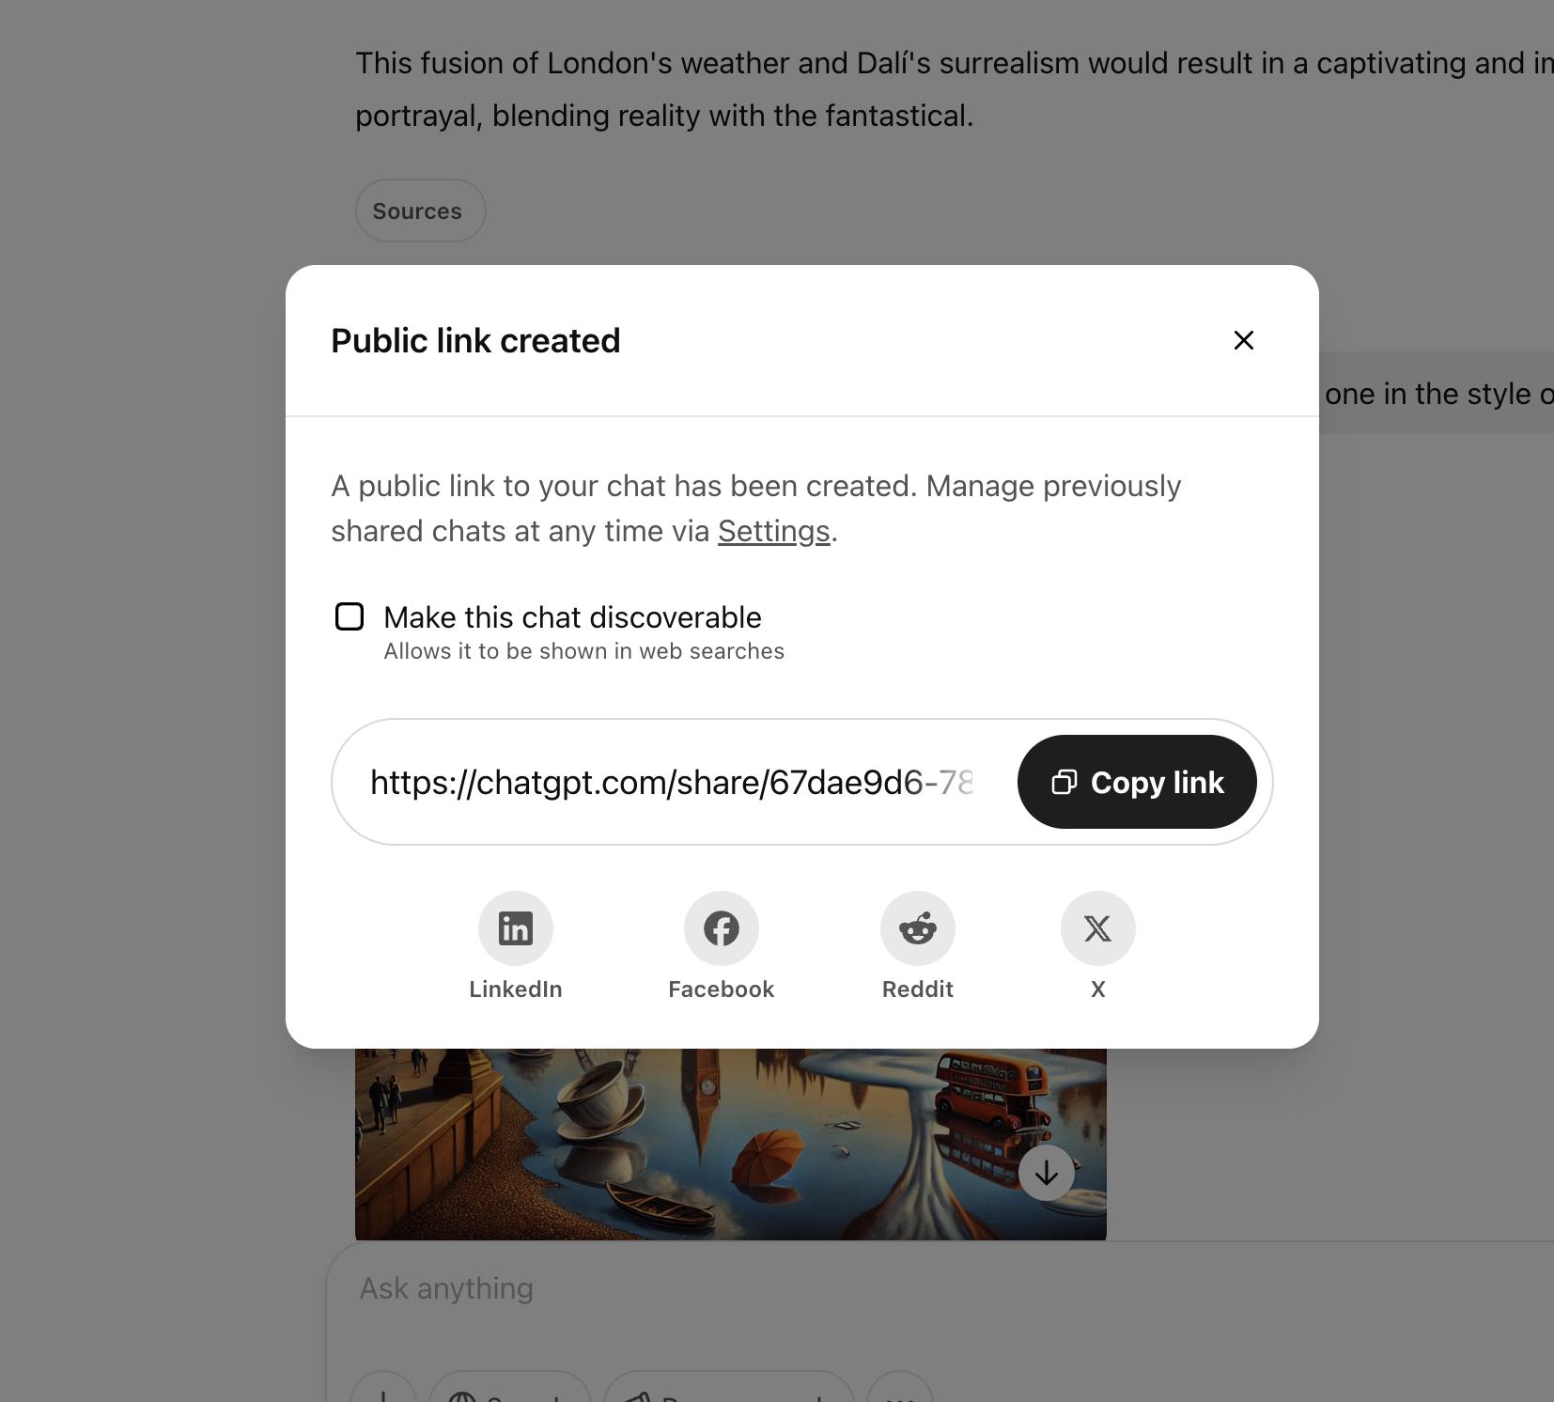
Share Your Conversations
You can share previous conversations with friends, family or co-workers.

Slide 6
Chat GPT Limitations

Slide 7
You cannot save Prompt Templates
Unlike some of the large language models on platform.openai.com, you cannot save any of the prompts directly within the ChatGPT interface.

